Slide 1




Understanding Key Documentation Requirements for WIOA Title I Eligibility and Work Authorization
WIOA III Convening
January 26, 2018

Slide 2


Introductions
Amanda Olmstead
Maryland Department of Human Services, Office for Refugees and Asylees
Workforce Programs Manager
Erin Roth
Department of Labor, Licensing and Regulation
Division of Workforce Development & Adult Learning
Director of Policy
Notes:
Amanda/Lauren

Slide 3
Session Overview
Goals:
  Understand WIOA Title I Adult Program eligibility basics
  Understand source documentation requirements for WIOA Title I program eligibility as it relates to certain special populations
  Understand work authorization documentation
Special populations to be discussed:
  Individuals with disabilities
  Immigrants
  Transgender
Notes:
Lauren

Slide 4
WIOA Title I Program Eligibility
&
Source Documentation
Notes:
Lauren

Slide 5
WIOA Title I Adult Program
Eligibility Basics
      18 years of age or older
      U.S. citizen or non-citizen authorized to work in the U.S.
      Meet Military Selective Service registration
Notes:
Lauren

Slide 6
Maryland’s Target Populations for the WIOA Title I Adult Program
Displaced Homemakers
Eligible migrant and seasonal farmworkers
Ex-offenders
Homeless individuals
Individuals facing substantial cultural barriers
Individuals with disabilities
Individuals within two years of exhausting lifetime eligibility under Part A of the Social Security Act
Individuals who are English language learners
Individuals who are unemployed
Individuals who have low levels of literacy
Individuals without a High School Diploma
Low income individuals
Native Americans, Alaskan Natives, and Native Hawaiians
Older individuals
Single parents
Veterans
Youth who are in or have aged out of the foster care system
Notes:
Lauren

Slide 7
Priority Populations &
WIOA Performance Levels
WIOA statistical adjustment model = based on actual participant characteristics & economic conditions
Characteristics of participants include:
  indicators of poor work history
  lack of work experience
  lack of educational or occupational skills attainment
  dislocation from high-wage and high-benefit employment
  low levels of literacy or English proficiency
  disability status
  homelessness
  ex-offender status
  welfare dependency
Notes:
Lauren

Slide 8
Required Source Documentation:
Work Authorization
Alien Registration Card indicating Right to Work
I-94
I- 94A
I-197
I-179
I-766
Baptismal Certificate (If place of birth is shown)
Birth Certificate
DD-214, Report of Transfer or Discharge (If place of birth is shown)
SNAP records
Foreign Passport Stamped Eligible to Work (Unexpired)
Hospital Record of Birth
Naturalization Certificate
Public Assistance Records
U.S. Passport or U.S. Passport Card (Unexpired)
Native American Tribal Document
Voter Notification Card
Consular Report of Birth Abroad
Notes:
Note: Per TEGL 02-14, Deferred Action for Childhood Arrivals (DACA) individuals are considered to be ―immigrants authorized by the Attorney General to work in the United States.‖ Therefore, DACA participants with employment authorization may access any WIOA services for which they otherwise would qualify.

Slide 9
Required Source Documentation: Selective Service
“A man turning 18 is required to register during the period of time beginning 30 days before, until 30 days after his 18th birthday.”
“Selective Service can accept a late registration, but not after a man has reached his 26th birthday.”
Source Documentation:
  Selective Service Acknowledgement Letter
  Form DD-214 ―Report of Separation‖
  Screen printout of the Selective Service Verification
  Selective Service Registration Card
  Selective Service Verification Form (Form 3A)
  Stamped Post Office Receipt of Registration
  NOTE: Certain exemptions exist
Notes:
The law requires virtually all male U.S. citizens and male immigrants residing in the U.S. to register within 30 days of their 18th birthday.
Therefore, to be in compliance with the law, a man turning 18 is required to register during the period of time beginning 30 days before, until 30 days after his 18th birthday.
Selective Service can accept a late registration, but not after a man has reached his 26th birthday. (www.sss.gov.)
Note: Certain limited exemptions exist and, in those instances, documentation for selective service exemption would suffice.
A non-registrant may not be denied any benefit if he can "show by a preponderance of evidence" that his failure to register was not knowing and willful. Offer as much evidence supporting your case, and as much detail, as possible.

Slide 10
Required Source Documentation: Selective Service
“Transgender individuals” refers to people whose gender identity and/or expression is different from the sex assigned to them at birth (e.g. the sex listed on an original birth certificate).
Selective Service Agency policy:
  Individuals who are born female and changed their gender to male are not required to register.
  U.S. citizens or immigrants who are born male and changed their gender to female are still required to register.

Slide 11
Required Source Documentation: Individuals with Disabilities
Letter from DORS or BHA verifying disability
Developmental Disabilities Administration (DDA) certificate for long term supports
Social Security Administration disability records
Statement or Diagnosis from a PhD, MD, LCSW or other licensed clinical professional
School records
Workers Compensation records
Veterans Administration letter/records
Agency attestation that the individual receives specialty services within the Public Health System
DHS approval letter for either Temporary Disability Assistance Program (TDAP) or Public Assistance to Adults (PAA) Program
Self-certification
Notes:
School records = (Individualized Education Plan, 504 Plan, exit documents or other documentation stating disability)
Self-certification (Participant identifies status and signs and dates paperwork)
Self-certification should only be used in circumstances where alternative documentation is unavailable.
Self-certification occurs when a participant states his or her status for a particular data element, such as pregnant or parenting youth, and then signs and dates a form acknowledging this status.
In accordance with TEGL 22-15, the key elements for self-certification are: (a) the participant identifying his or her status for permitted criteria and (b) signing and dating a form attesting to this self-identification.
USDOL and DLLR will monitor for overuse of self-certification when determining program eligibility.

Slide 12
Resources
Maryland DLLR Policy Issuance 2016-10: -http://www.dllr.state.md.us/employment/mpi/mpi10-16.pdf
USDOL Training & Employment Guidance Letter 26-15 - https://wdr.doleta.gov/directives/attach/TEGL/TEGL_26-15_Acc.pdf
Selective Service site - https://www.sss.gov/Registration-Info/Who-Registration
Selective Service “Who Must Register?” – https://www.sss.gov/Portals/0/PDFs/WhoMustRegisterChart.pdf
Notes:
Lauren

Slide 13
Work Authorization
Notes:
Lauren

Slide 14
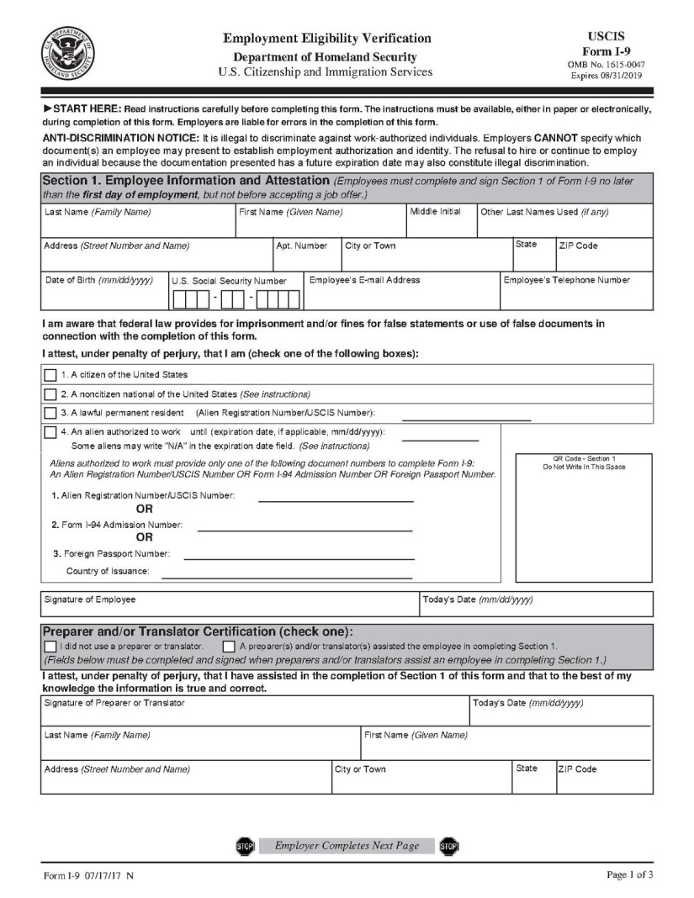
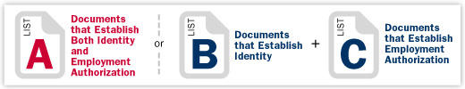
Work Authorization
Individuals must fulfill Form I-9 requirements to be able to work legally
Form I-9: Employment Eligibility Verification
Requirements came out of the 1986 Immigration Reform and Control Act, which prohibits employers from:
  Knowingly employing a non-work authorized individual
  Continuing to employ an individual knowing that he or she is unauthorized for employment
  Hiring any individual without verifying his or her identity and employment authorization on Form I-9
Notes:
Amanda

Slide 15
Work Authorization Docs: List A
U.S. Passport
Permanent Resident Card or Alien Registration Receipt Card
Foreign passport that contains a temporary I-551 stamp
Employment Authorization Document
Foreign passport and Form I-94
A passport from the Federated States of Micronesia (FSM) or the Republic of the Marshall Islands (RMI) with Form I-94 or Form I-94A
Notes:
Amanda

Slide 16
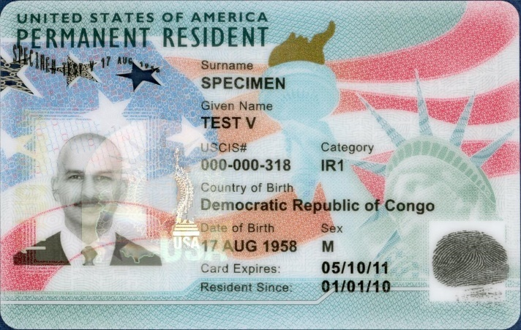
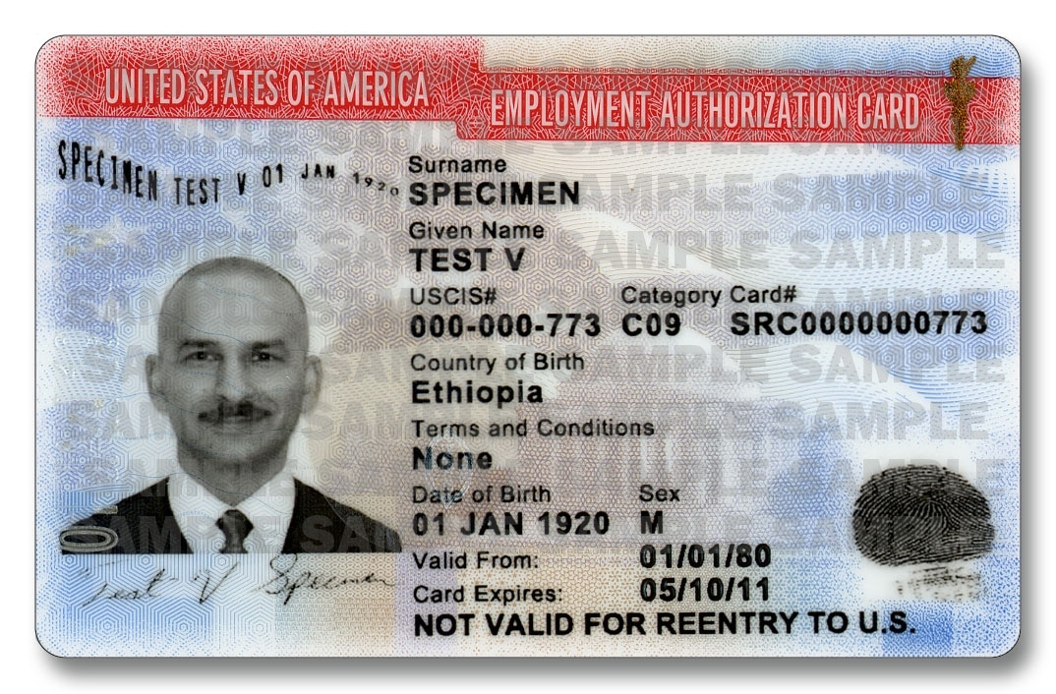
Immigrant Work Authorization Docs: List A
Permanent Resident Card or Form I-551 (known as Green Card)
Employment Authorization Document (EAD) or Form I-765
Notes:
Amanda

Slide 17
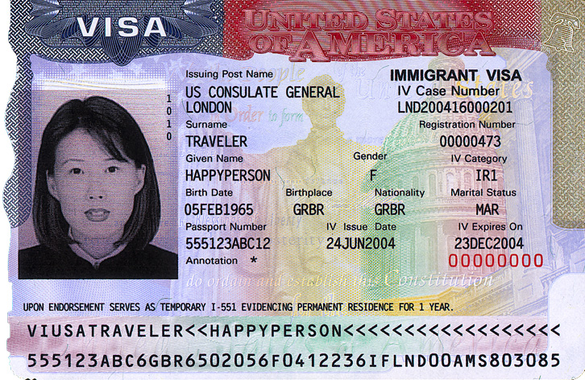
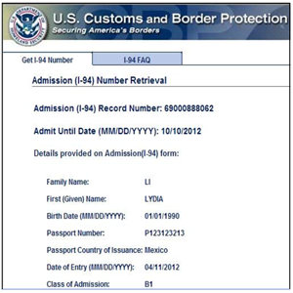
Immigrant Work Authorization Docs: List A
Foreign Passport with I-551 stamp
Foreign passport with Form I-94 or Form I-94A with Arrival-Departure Record, and containing an endorsement to work
Passport from the Federated States of Micronesia or the Marshall Islands (RMI) with Form I-94
Notes:
Amanda

Slide 18
Finding Immigrant Status

Slide 19
Work Authorization Docs: List B
Driver’s License
Government-issued ID card
School ID card with a photograph
Voter registration card
U.S. military card or draft record
Military dependent’s ID card
U.S. Coast Guard Merchant Mariner Document card
Native American tribal document
Driver’s license issued by a Canadian government authority
Notes:
Amanda

Slide 20
Work Authorization Docs: List C
Unrestricted Social Security Number
U.S. Birth Certificate
Consular Report of Birth Abroad (Form FS-240)
Certification of Birth Abroad issued by the U.S. Department of State (Form FS-545)
Certification of Report of Birth issued by the U.S. Department of State (Form DS-1350)
Employment authorization document issued by the Department of Homeland Security, such as I-94
Notes:
Amanda

Slide 21
Further Guidance on
Immigrant Work Authorization
U.S. Citizenship and Immigration Services: https://www.uscis.gov/i-9-central/acceptable-documents/list-documents/form-i-9-acceptable-documents
U.S. Department of Justice Civil Rights Division – Immigrant and Employee Rights: https://www.justice.gov/crt/immigrant-and-employee-rights-section
U.S. Department of Justice – Refugee/Asylee Right to Work: https://www.justice.gov/sites/default/files/crt/legacy/2011/05/20/Refugee_Asylee_Flyer_English.pdf
Notes:
Amanda

Slide 22
Questions?

