Slide 1
Every Student Succeeds Act (ESSA)
Governor’s P-20 Council
June 6, 2017

Slide 2
Highlights of Major Sections of the Law and Maryland’s Plan
Purpose
Timeline
Accountability
Support to Educators
Support to Students

Slide 3
ESSA - Purpose
Provide all students the opportunity receive a fair, equitable, and high quality education, and to close educational achievement gaps by:
Establishing State standards, setting academic goals, and assessing progress toward those goals for all students and schools
Measuring and reporting performance of all students, schools, and Local Educational Agencies (LEAs)
Identifying and supporting schools in need of improvement
Supporting professional development and growth for educators
Supporting students to ensure a well-rounded education

Slide 4
Timeline for ESSA and Submission of Consolidated State Plan
December 10, 2015 - Signed by President Obama
February 2016 – Committees formed to begin work, outreach, and monthly discussion with the State Board
December 2016 - First Draft of Maryland’s Plan available for feedback
January 2017 – Maryland’s ESSA Listening Tour
June 2017 – “Final Draft” submitted to Governor, Legislative Policy Committee, and Website
August 2017 – Final Review by the State Board
September 18, 2017 – Submission to the U.S. Department of Education (120 day approval process)
2017-2018 School Year – First year of implementation

Slide 5
Accountability
Frameworks
Selected measures
Goals
Example report card, dashboard
Comprehensive Support and Improvement (CSI) Schools and Targeted Support and Improvement (TSI) Schools
2

Slide 6
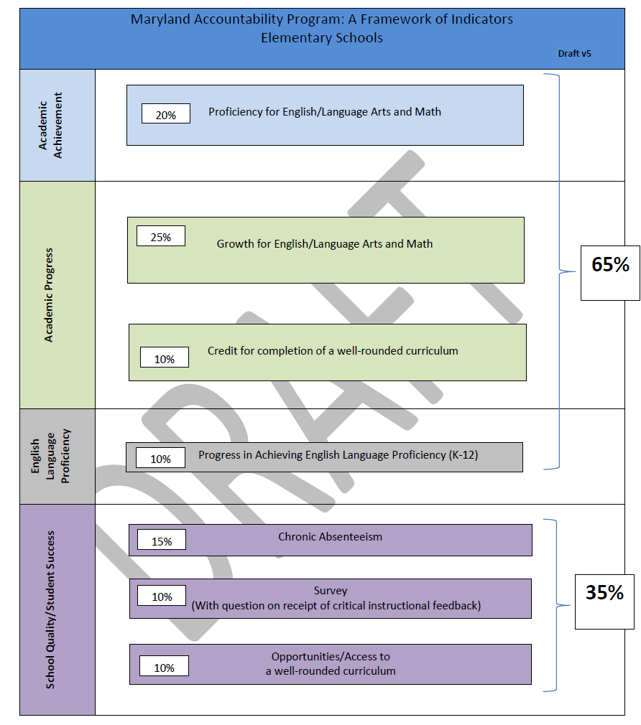
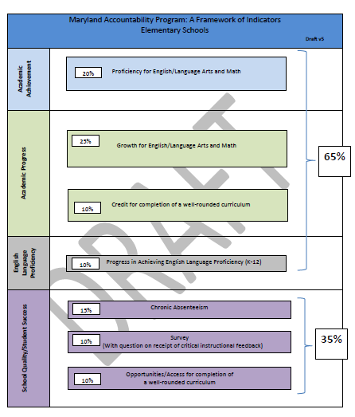

Elementary School Framework

Slide 7
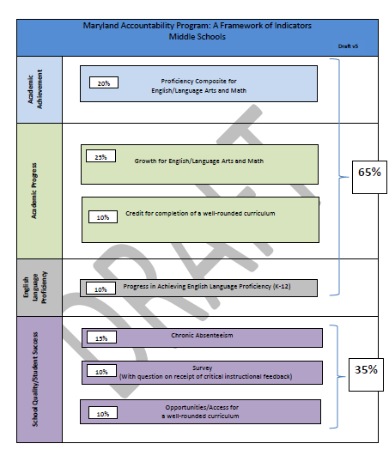
Middle School Framework

Slide 8
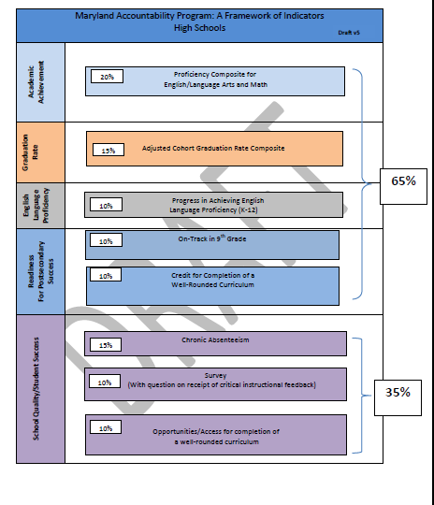
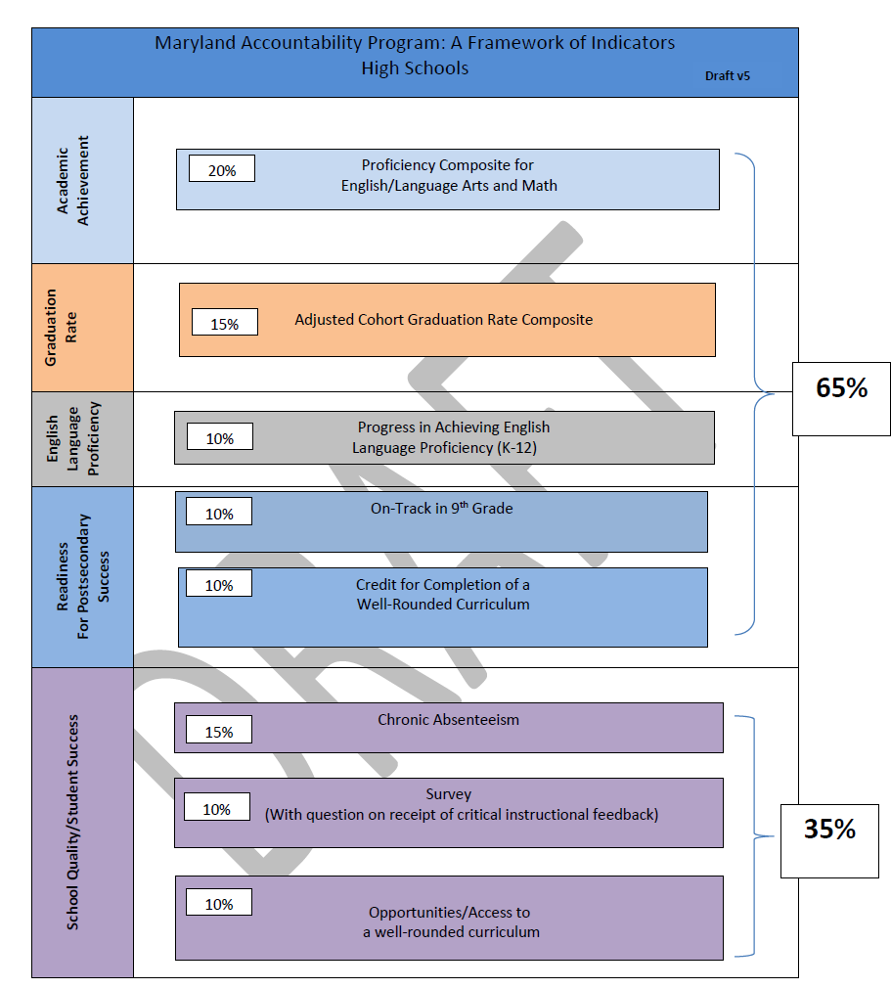
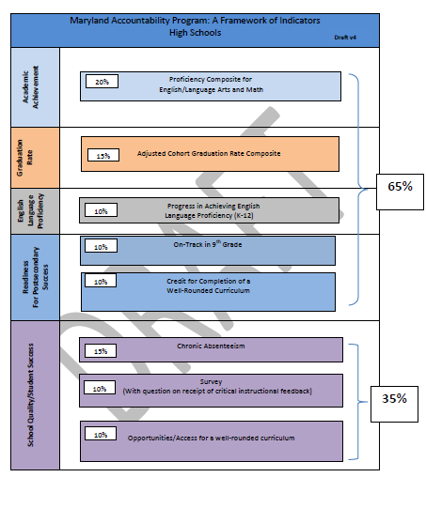
High School Framework

Slide 9
Requirements and Constraints
ESSA
Indicators must be of significant weight
Academic must be of greater weight than Non-Academic
Protect Our Schools Act
Indicators must be 10%
Academic must be 65% and Non-Academic must be 35%
3 Categories for Indicators and Final Summative
Cannot be A-F
No/Minimal Summative calculation requirements
Summative must use percentiles
Non-Academic indicators must be valid and reliable
Non-Academic indicators must include a survey and each measure must be at least 10%

Slide 10
Selected measures
6

Slide 11
Academic Achievement Recommended measure: Achievement composite
Math composite: 10% of accountability score | ELA composite: 10% of accountability score
Performance index, Math 50% of math composite | Performance index, ELA 50% of ELA composite
AND | AND
Percent proficient+, Math 50% of math composite | Percent proficient+, ELA 50% of ELA composite
9

Slide 12
Comparing recommended (composite) and alternative achievement measures
 | Performance Index | Percent proficient+ | Composite
Message | We value achievement at all levels. | We have a standard. | We have a standard, and also value achievement above and below it.
“High achieving” schools have… | Few 1’s and 2’s | More 4’s than 3’s | Both
Is a 3 “valued”? | Yes | No | Partially
Unintended consequences | Schools might focus on students at the boundaries. | Schools might focus on students at the 3/4 boundary. | Both, but one offsets the other.
SGP would also offset focusing on boundaries because all growth is recognized, not just growth across a boundary.
13

Slide 13
Academic Achievement
The composite will be used as the academic achievement measure.
The weight of the performance index and percent proficient+ will be 50-50.
In the performance index, a PARCC level 5 is “worth” a 5.
15

Slide 14
Academic Progress Recommended measure: Student growth percentile
(Note: MD will study a Growth-to-Standard Model in combination with the SGP)
SGP, Math: 12.5% of accountability score | SGP, ELA: 12.5% of accountability score
Median SGP, Math | Median SGP, ELA
16

Slide 15
Academic Progress (Elementary School)
Credit for completion of a well-rounded curriculum
5% - Percent of students scoring proficient on the Maryland Integrated Science Assessment (MISA) which will be field tested with MD fifth graders 2016-2017 and will be operational in 2017-2018.
5% - K-3 Progress (DRAFT/Under study)
Maryland will investigate this measure

Slide 16
Academic Progress (Middle School)
Credit for completion of a well-rounded curriculum
3.5 % - The Maryland Integrated Science Assessment (MISA) will be field tested with MD eighth graders 2016-2017 and will be operational in 2017-2018.
3.5% - Social Studies Assessment will be field-tested in 2018-2019 and will be operational in 2019-2020.
3.0% - Percent of students passing certain subjects in 8th grade

Slide 17
Graduation Rate – High Schools
Four Year Cohort Rate (10%)
Five Year Cohort Rate (5%)

Slide 18
English Language Proficiency
Progress in achieving English Language Proficiency
Percentage of students making progress towards attaining English Language Proficiency as measure by growth on the Access assessment for English Language Learner

Slide 19
Readiness for Post Secondary Success
10% - On-track in 9th grade – percent of 9th grade students earning at least 4 credits in English/Language Arts, Math, Social Studies, Science or World Language
10% - Credit for Completion of a Well Rounded Curriculum

Slide 20
Credit for completion of a well- rounded curriculum (High School) – subject to approval
Percent of 12th grade students graduating or exiting with a certificate of completion, and receiving any of the following:
Score of 3 or better on an Advanced Placement (AP) Exam or score of 4 or better on an International Baccalaureate (IB) Program Exam,
Meet a standard set by the College Board on the SAT examination (score of 530 or higher (math) and 480 or higher (reading)),
Meet a standard set by ACT, Inc. on the ACT examination (score of 21)
Credit for Dual Enrollment,
Completion of an industry certification or apprenticeship from a Career and Technology (CTE) Program,
Meet a standard on the ASVAB examination (standard to be determined pending study),
Enrollment in a postsecondary institution within 16 months after graduation.
Entered the world of work** through gainful employment; post secondary education and training; supported employment; and/or other services that are integrated in the community.
29a

Slide 21
School Quality/Student Success: Access to
a well-rounded curriculum (All Schools)
Elementary School: Enrolled in Science, Social Studies, Fine Arts, Physical Education, and Health
Middle School: Enrolled in Fine Arts, Physical Education, Health, STEM, Technology, Computer Science
High School: Enrolled in Advanced Placement (AP), International Baccalaureate (IB), Career and Technology Education (CTE) Concentrator
30a

Slide 22
Goals
ESSA: We must have ambitious long-term goals and measurements of interim progress for academic achievement, graduation rate, and EL proficiency.
36

Slide 23
Academic achievement long term and interim goals Option A: Annual Measurable Objective methodology Closing achievement gaps
Meeting interim targets will result in closing achievement gaps
Closing achievement gaps: Every student group will start in a different place depending on the baseline, and student groups farthest behind have the most progress to make.
Baseline
39

Slide 24
MSDE recommends the AMO method, cutting proficiency gaps in half by 2030
MSDE recommends long term and interim goals that are rigorous and attainable.
A Proficiency Level of 4 and 5 is both a rigorous and attainable goal.
Currently over half of the student groups at elementary and middle schools have a percent proficiency of less than 30%.
Using a long term goal of 2030, the interim targets would be 2.7% or greater, which is rigorous and attainable.
Although a state target of 90% would be rigorous, the interim targets would not be reasonable nor attainable.
Stakeholders strongly recommended attainable and realistic goals.
No. of Student Groups at Proficiency Ranges
40

Slide 25
Identification of Comprehensive Support and Improvement (CSI) Schools
The lowest five percent of Title I schools based on the accountability system (identified in 2018-2019; approximately 22 schools)
High schools with a 4-year cohort graduation rate of less than 67 percent (identified in 2018-2019; approximately 30 schools)
School Improvement Grant (SIG) IV schools (includes five schools which began implementation in 2016-2017 and will continue through 2020-21)
Low performing student group (TSI) schools with a student group performing in the bottom five percent of all students based on the accountability system for two years (to be identified in 2021-22)
Other State Identified Schools: Maryland will also identify all schools in the bottom 5 percent based on the accountability system. (identified in 2018-2019; approximately 70-80 schools)
46

Slide 26
Identification of Targeted Support and Improvement (TSI) Schools
Low-performing student group TSI Schools: Schools with one or more low-performing student groups performing below the summative performance of the “all students” student group in any of the lowest performing five percent of Title I schools (identified in 2018-2019) or a school does that not meet its 95 percent participation for any student group.
Consistently underperforming TSI Schools: Schools with any student group not meeting its annual targets for two or more years based on the accountability system (identified in 2019-2020)
47

Slide 27
Identifying the Lowest 5% of Schools
ESSA- States must:
Create a “meaningful differentiation” system for all schools
Create a “State determined methodology” based on the system of “meaningful differentiation”
Protect Our Schools Act:
Each LEA must develop an Improvement Plan which must include “the school quality indicators described in…” the State law

Slide 28
Support to Teachers
Teacher preparation reform, aligned with teacher requirement, induction, and retention
Expand the skills of educators
Expand Certification Options
Provide support to all educators

Slide 29
Support to Students
Provide all students with access to a well-rounded education;
Improve school conditions for student learning; and
Improve the use of technology in order to improve the academic achievement and digital literacy of all students.

Slide 30
Improve access and opportunity
Providing support for students taking the Advanced Placement (AP) or International Baccalaureate (IB) exams;
Advanced level coursework for all students;
Access to instruction in all content areas beginning in Prekindergarten;
Strategies to encourage and provide access to integrated STEM core concepts and practices for all students, specifically for female and students of color;
More college preparatory support in all schools, specifically focusing on low-income schools (i.e. Advancement Via Individual Determination (AVID) Program);
Diverse fine arts options for all students to foster creative problem solving, individual growth, meaningful expression, and innovation;
Quality physical education for all students to gain the academic and health benefits of movement and fitness;
Comprehensive health education that provides students the skills to adopt and sustain behaviors that promote a healthy lifestyle and reduce health risks

Slide 31
Improve the effective use of technology
School systems have limited capacity and resources to provide and/or expand access to high quality digital learning experiences for all students including students in remote and rural areas and under-represented student groups.
School systems often do not have trained staff members who possess the necessary qualifications to review digital resources, including online courses, for web accessibility compliance.
Educators and students must be provided flexible platforms that allow for online professional development and student course delivery (Learning Management System).
There is a lack of equity in regard to support provided by LEAs for their school library media programs.

Slide 32
Other
Improve the communication between home and schools.
Provide training of general education teachers across all content areas on language acquisition and strategies for serving English Learners (ELs) as this increases access for ELs to a well-rounded education; and,
Increase the training of teachers across all content areas on identifying and serving gifted and talented students to increase access and success for all students.

Slide 33

Questions?

