Slide 1
Prevailing Wage Step-by-Step:
Contractor Registration and
Manual Electronic Certified Payroll Submission
Notes:
‹#›

Slide 2
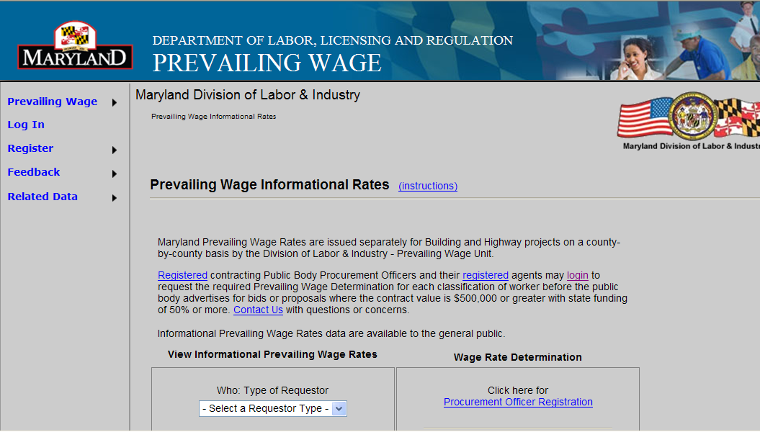
Navigate to the portal:
https://www.dllr.state.md.us/PrevWage/web/content/PWRequestRates.aspx
Notes:
‹#›

Slide 3
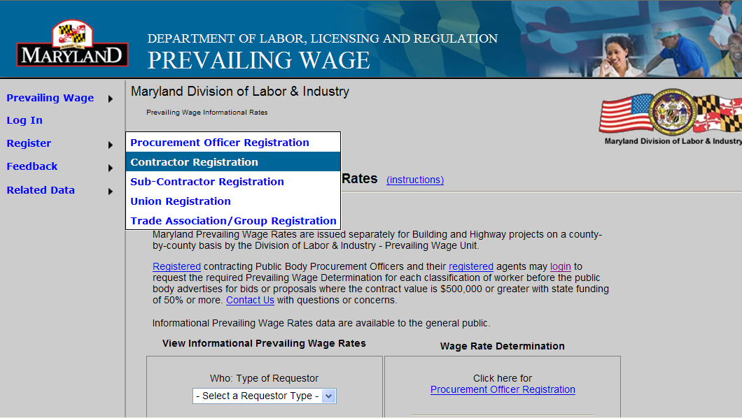
Notes:
‹#›

Slide 4
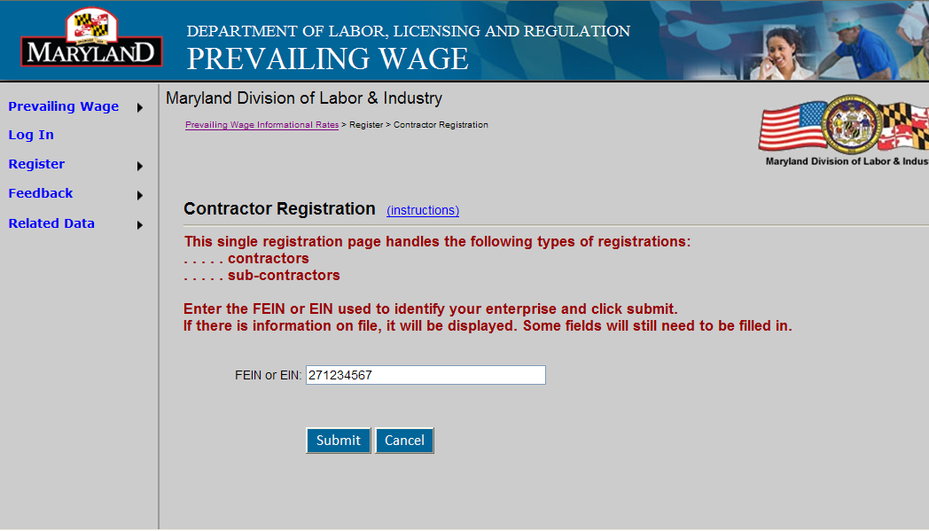
Every person that registers is under a FEIN or EIN. The FEIN allows the system to pre-populate all the forms generated by this system.
Notes:
‹#›

Slide 5
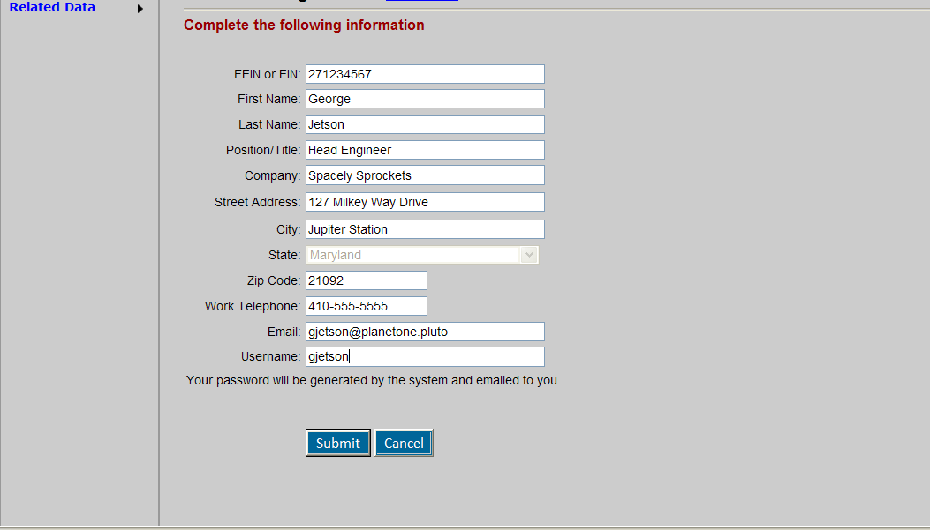
Select a user name you will remember or write it down for future use
Notes:
‹#›

Slide 6
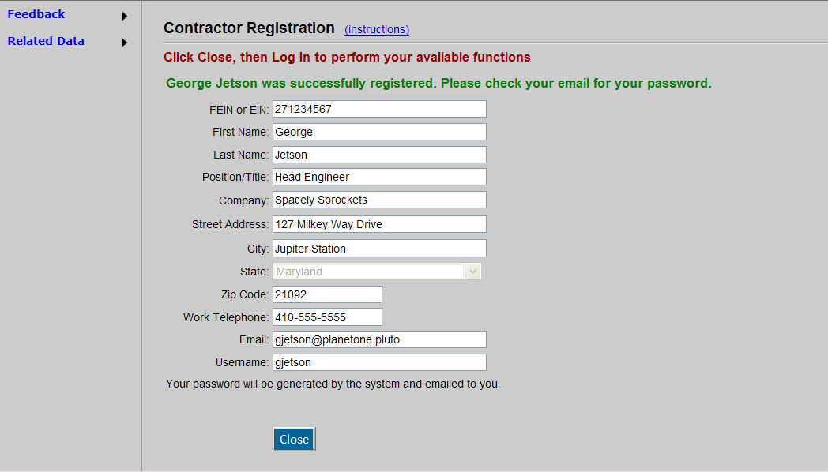
As soon as you submit your form you will get a message on the screen requesting you to check your email for your TEMPORARY PASSWORD.
Notes:
‹#›

Slide 7
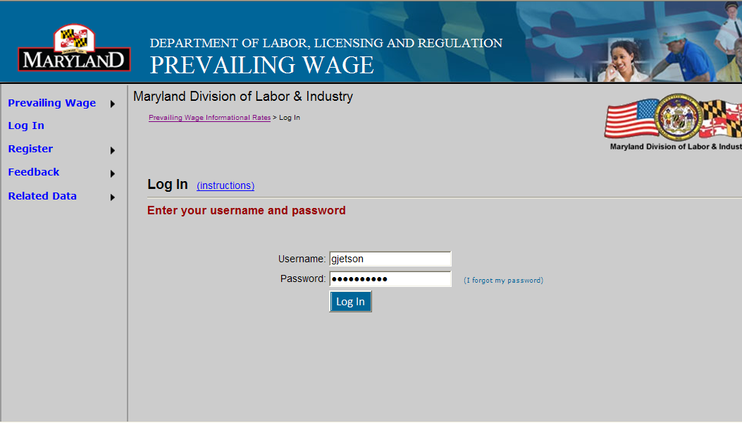
COPY and PASTE your TEMPORARY PASSWORD. The screen will change slightly, watch the left hand dropdowns. Then select PERSONNEL and then the dropdown “MY DETAILS” to get to the next screen.
Notes:
‹#›

Slide 8
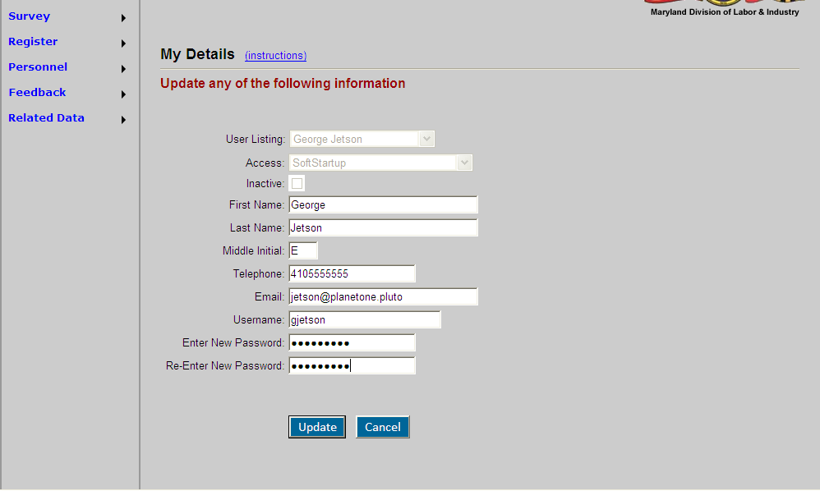
Choose a password of at least 6 letters or numbers that you can remember. Reenter it exactly and hit the “UPDATE” button.
Notes:
‹#›

Slide 9
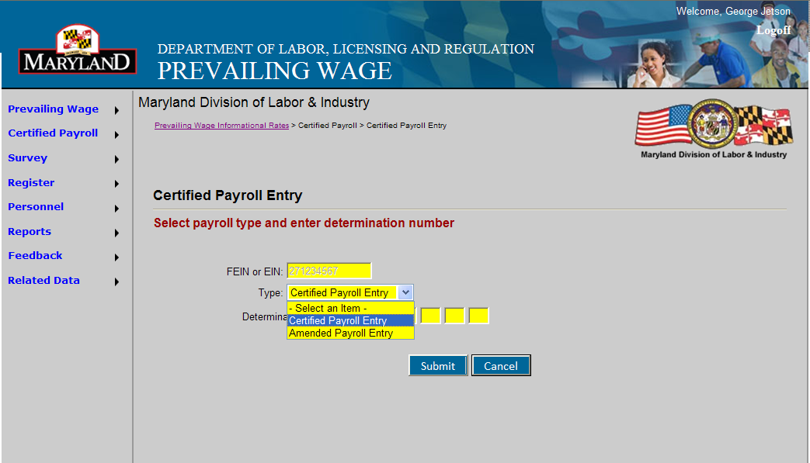
You will now see the “CERTIFIED PAYROLL” button on left. Select that button and enter your companies FEIN and the type of payroll to be entered (regular or amended)
Notes:
‹#›

Slide 10
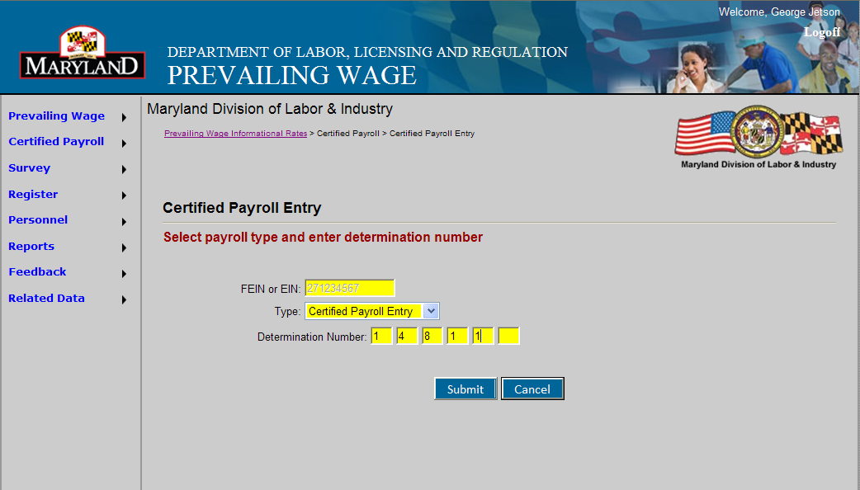
Every Maryland Prevailing Wage project has a determination number of at least 5 digits. Entering this number will pre-populate the form for you with the boilerplate information concerning your project.
Notes:
‹#›

Slide 11
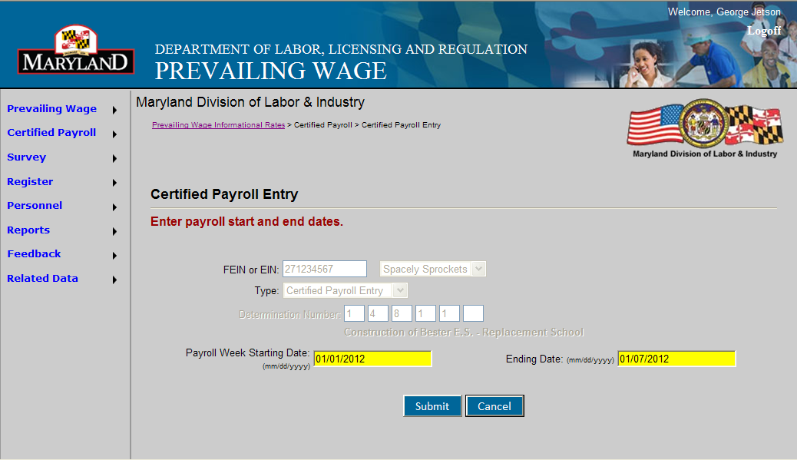
Select the start and end dates of the work week you are reporting. Remember, even if your payroll is biweekly, certified payrolls must still be reported weekly.
Notes:
‹#›

Slide 12
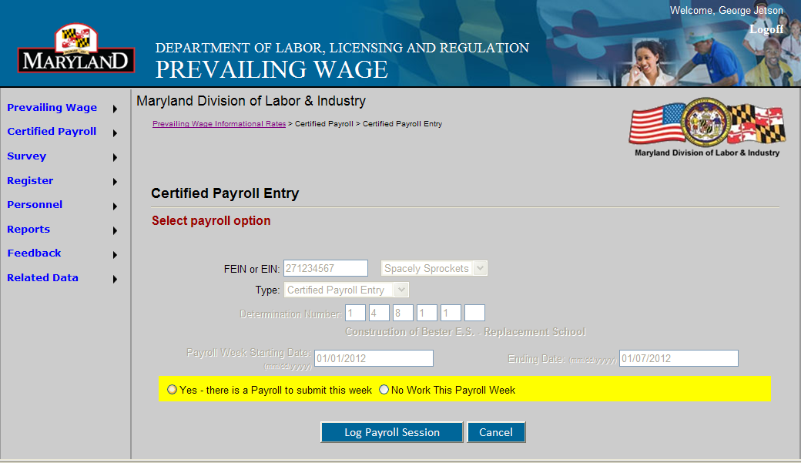
Choose either “PAYROLL” or “NO WORK.” If your employees worked on the project, select “PAYROLL,” and then “LOG PAYROLL SESSION”
Notes:
‹#›

Slide 13
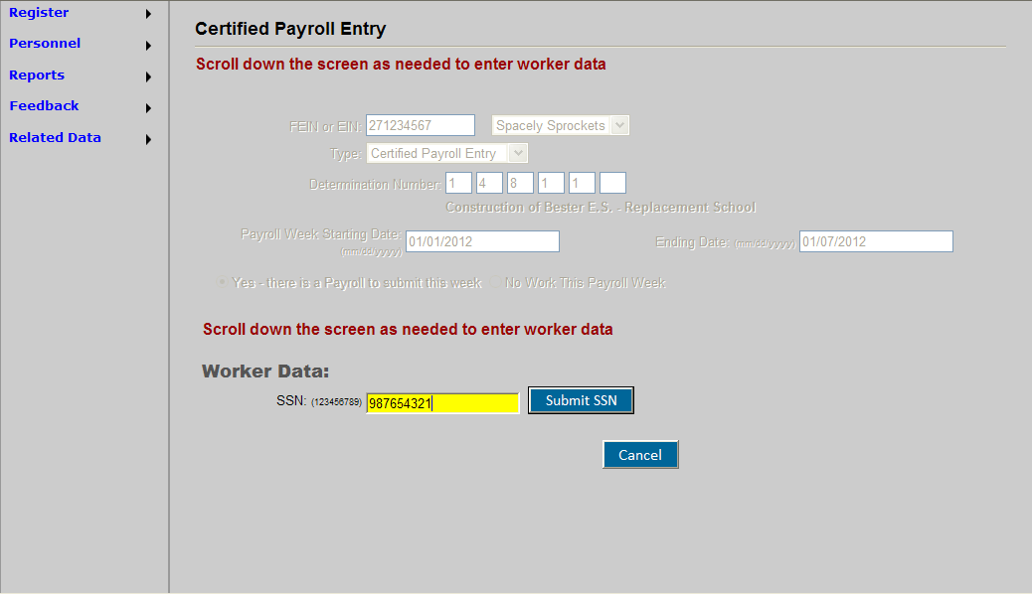
SSN must be entered manually the first time. After the first submission the form will pre populate with employees’ information.
Notes:
‹#›

Slide 14
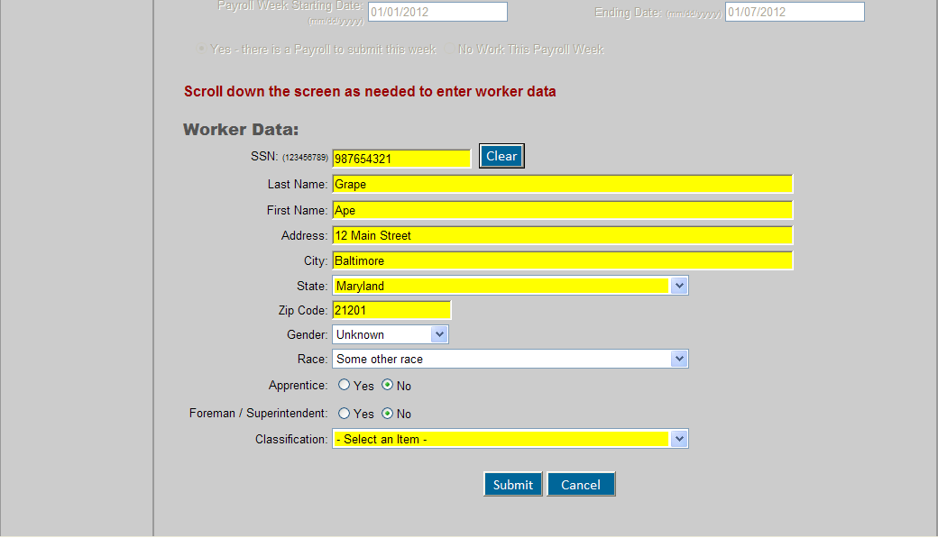
Fill in any fields the form has not pre-populated. All workers performing work on the project must be reported. If the employee is a Foreman/Superintendent or an Apprentice, select the correct button. Select the correct “CLASSIFICATION”.
Notes:
‹#›

Slide 15
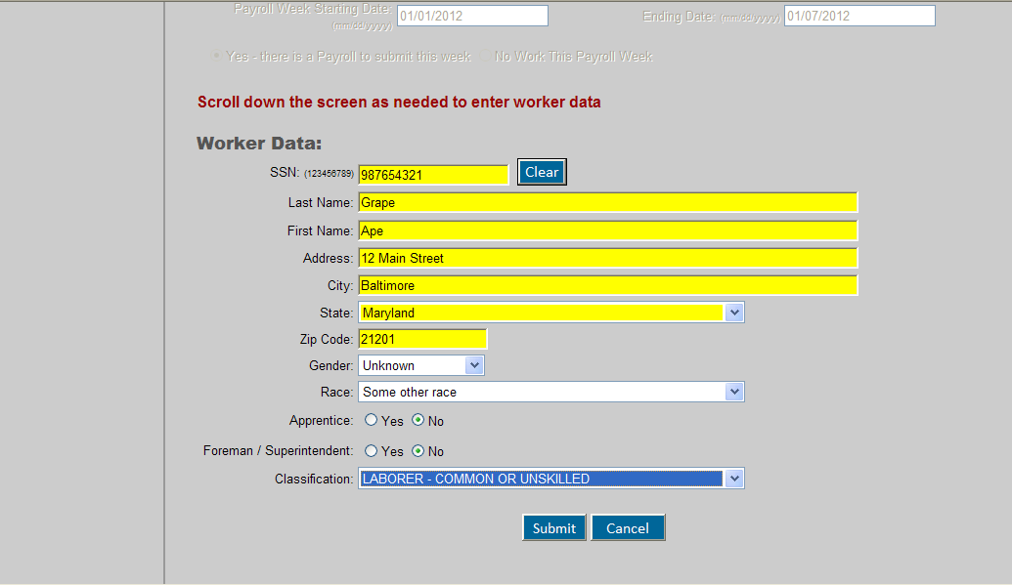
Once the correct “CLASSIFICATION or CRAFT” has been selected, press “SUBMIT FORM.”
Notes:
‹#›

Slide 16
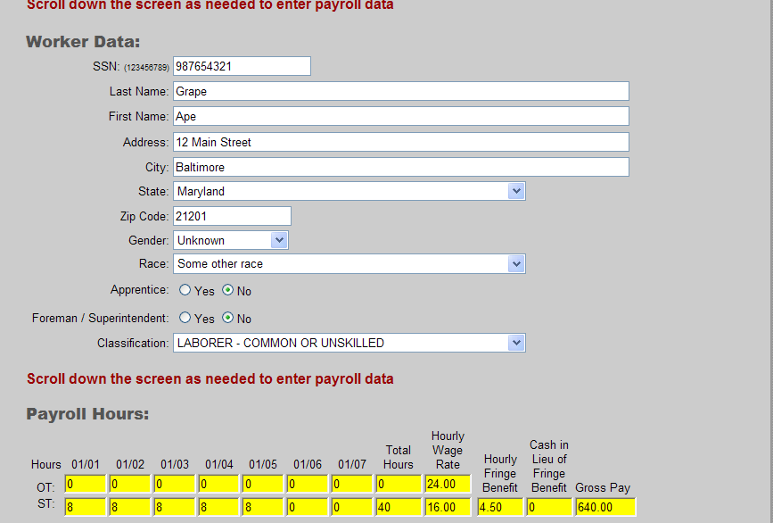
Enter for each day all hours worked by the employee on the project. You must fill in the totals as the form does not enter the math for you.
Notes:
‹#›

Slide 17
January 2012
S | M | T | W | T | F | S
1 | 2 | 3 | 4 | 5 | 6 | 7
8 | 9 | 10 | 11 | 12 | 13 | 14
15 | 16 | 17 | 18 | 19 | 20 | 21
22 | 23 | 24 | 25 | 26 | 27 | 28
29 | 30 | 31
The selection of payroll start and end dates are at the election of the employer. The first day displayed on the certified payroll form conforms to the date on the calendar.
Notes:
‹#›

Slide 18
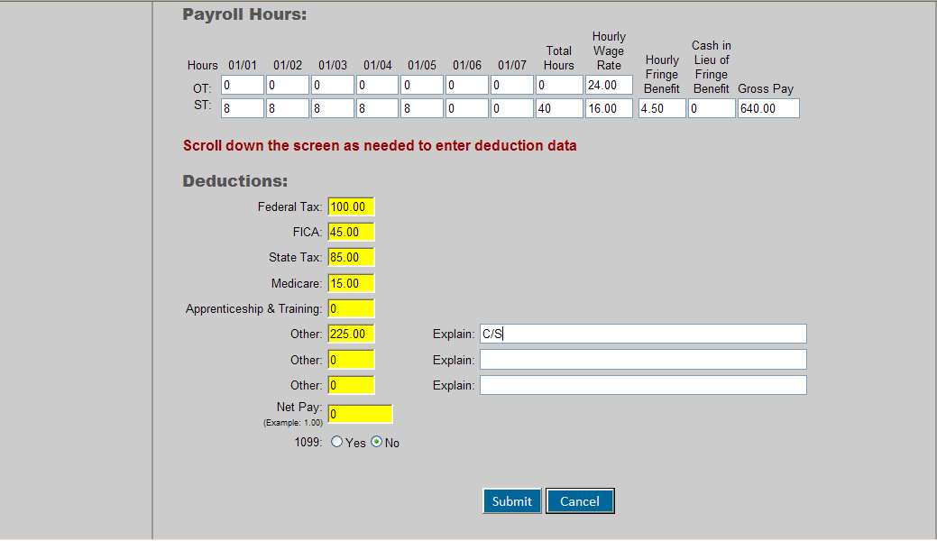
Enter the deductions for each employee. If a deduction is not listed and you have entered “OTHER,” provide a short explanation. Here this is CHILD SUPPORT, something ordered by the court like a wage garnishment or tax lien.
Notes:
‹#›

Slide 19
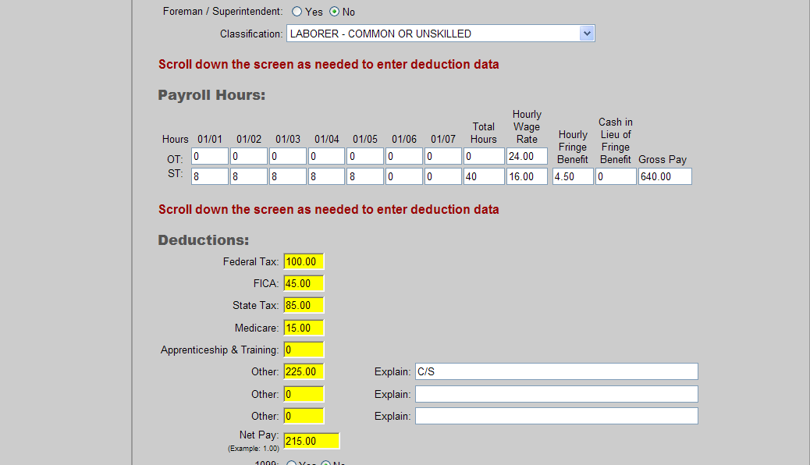
Total all deductions and submit. Maryland Law requires GROSS and NET pay to be submitted on payroll form.
Notes:
‹#›

Slide 20
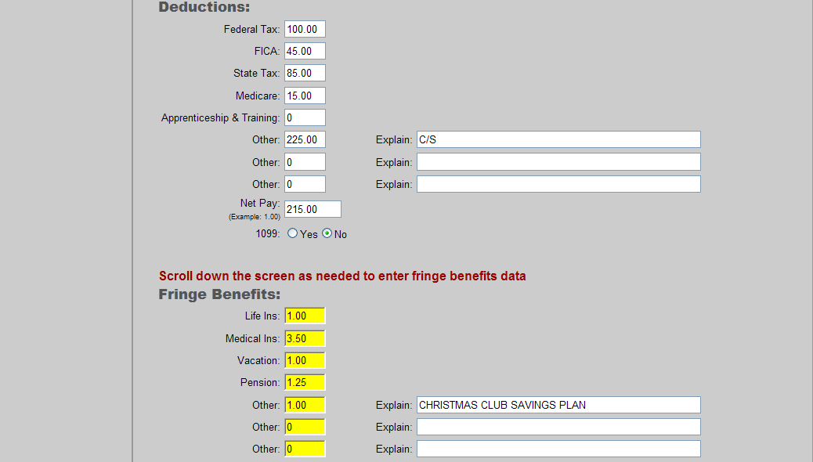
Report the hourly cost of each benefit paid by the employer, and then total. Explain anything that is listed under other.
Notes:
‹#›

Slide 21
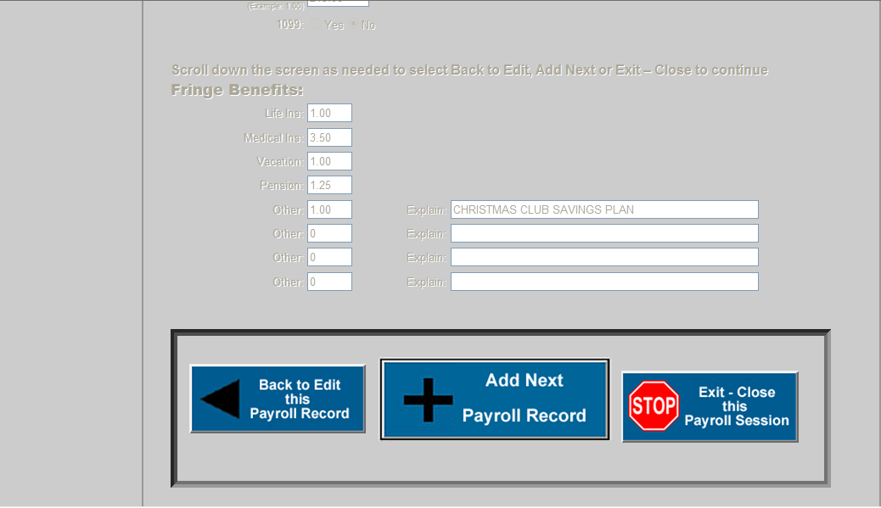
You have just finished the first employee. If you have another employee to enter you would choose “ADD NEXT PAYROLL RECORD”. If this is the only employee chose “STOP”. Double check your work! This is the point at which you can edit this payroll record (by clicking “Back to Edit”)
Notes:
‹#›

Slide 22
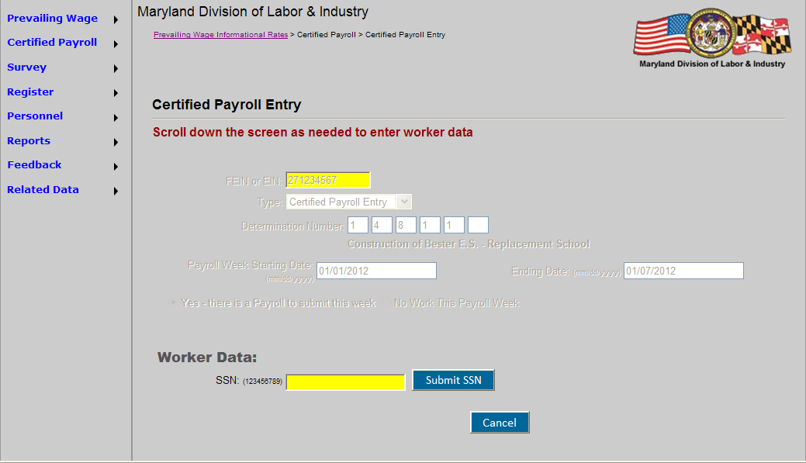
If you had another employee, you would add his/her SSN here. The form remembers all the boiler plate from the determination number.
Notes:
‹#›

Slide 23
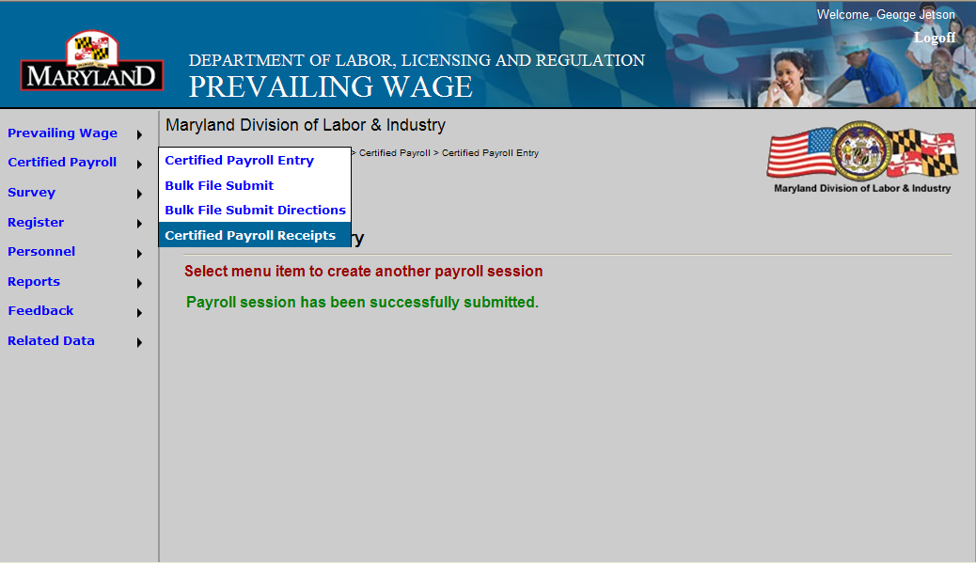
Assuming you were finished entering employee information, you would proceed to get your receipt of this session. The green line lets you know that you were successful in entering your payroll.
Notes:
‹#›

Slide 24
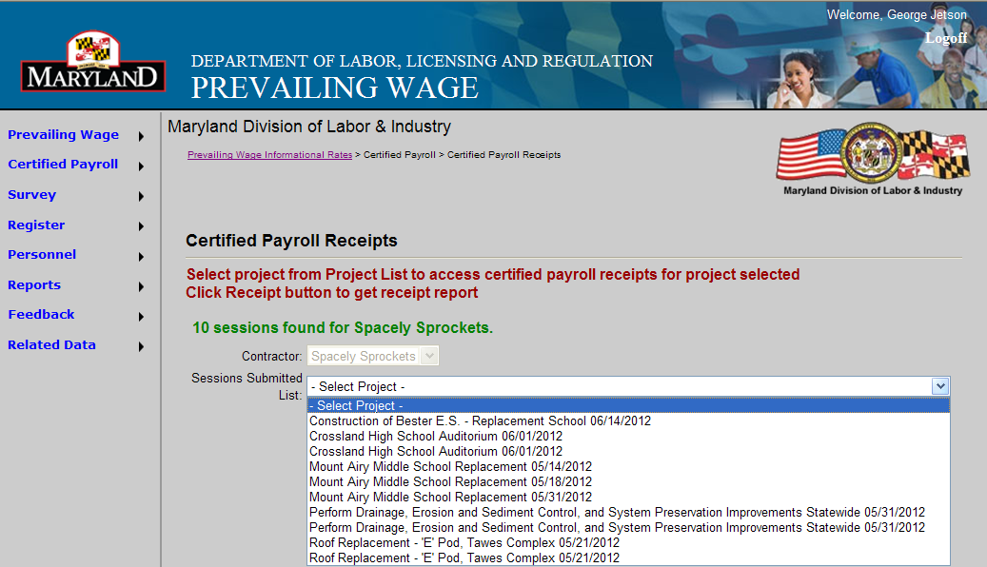
The system will bring up all the receipts for all sessions that have been logged. Choose the correct date.
Notes:
‹#›

Slide 25
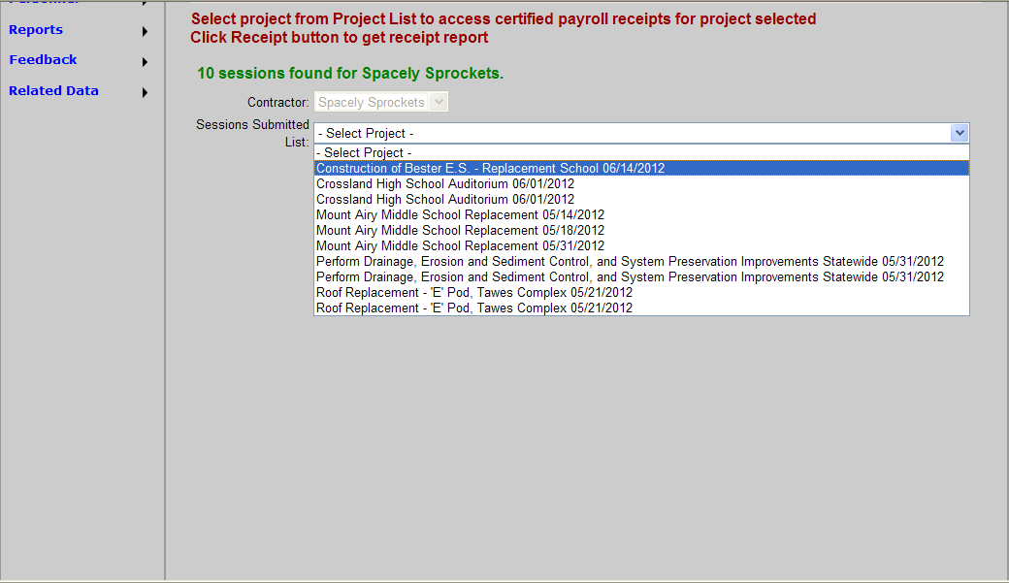
Notes:
‹#›

Slide 26
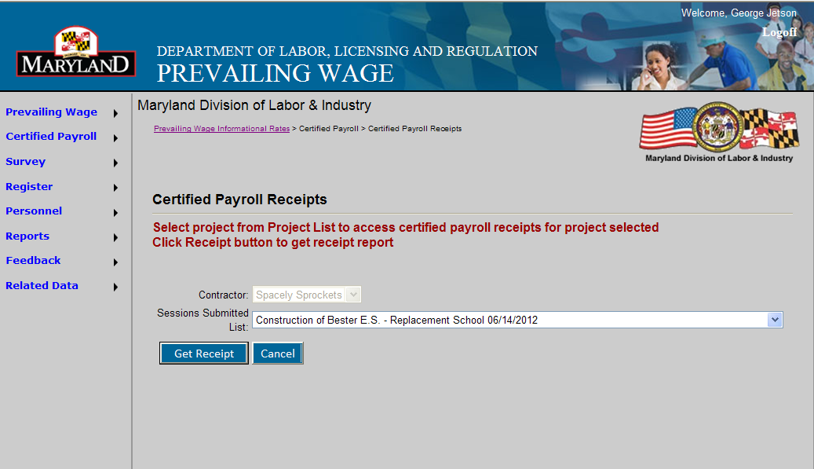
Notes:
‹#›

Slide 27
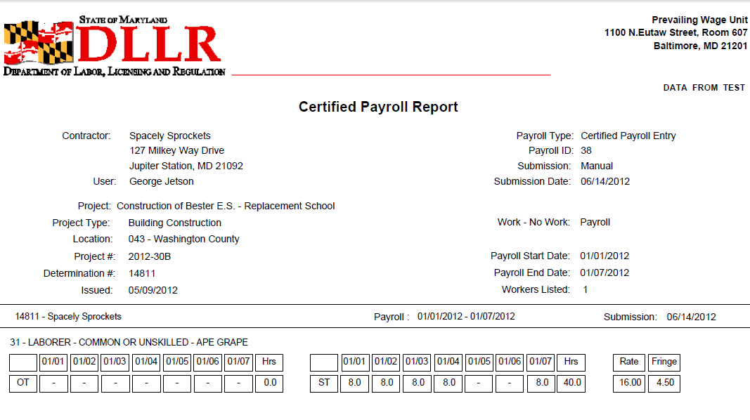
Here printed on STATE LETTERHEAD is your receipt. You can email this receipt to the general contractor by selecting “FILE” and “SEND TO”. You can send this receipt to as many peoples addresses as necessary to fulfill your contractual obligation. If you forgot to send someone a copy then log back into the system and get your receipt again,as they are maintained in the system.
Notes:
‹#›

Slide 28
Example of “NO WORK WEEK” submittal.
Notes:
‹#›

Slide 29
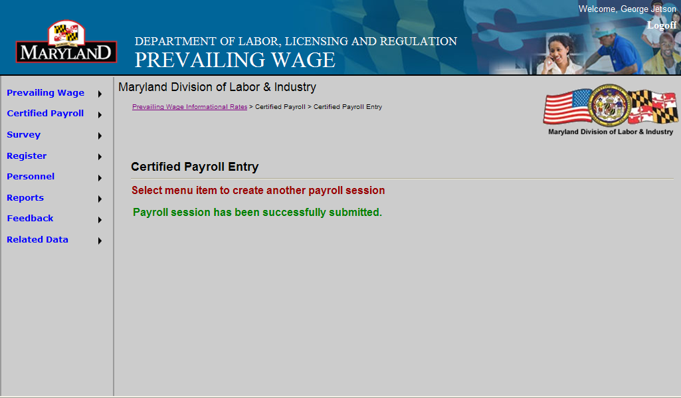
Once NO WORK is submitted employer only needs to “GET RECEIPT”
Notes:
‹#›

Slide 30
Notes:
‹#›

Slide 31
Notes:
‹#›

Slide 32
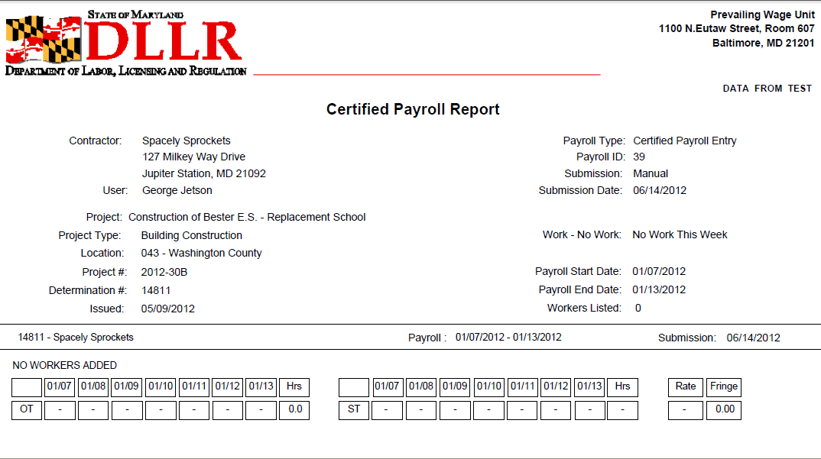
Notes:
‹#›

Slide 33
Additional Resources:
https://www.labor.maryland.gov/labor/prev/
Questions?
Tel: 410-767-2342
Email: dldliprevailingwage-labor@maryland.gov
Notes:
‹#›
Governor / Secretary / Commissioner

